Slide 1
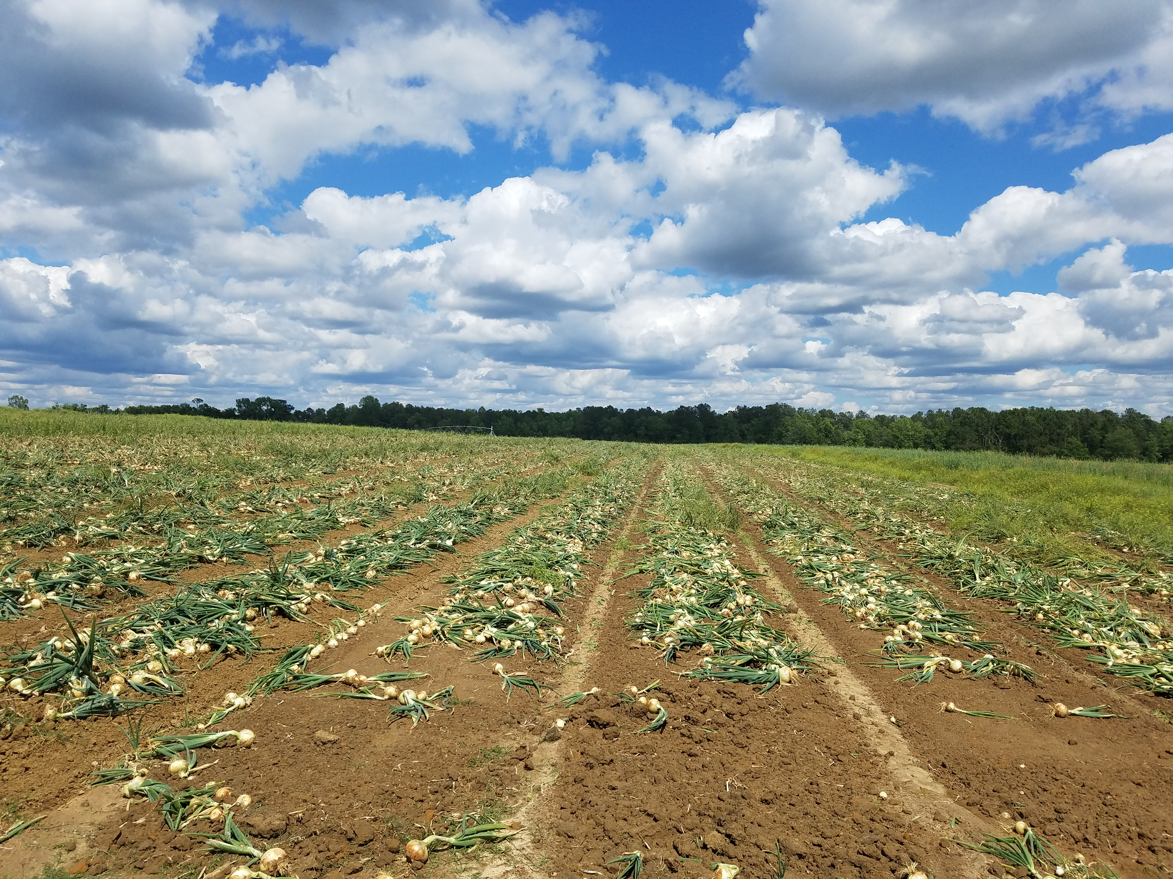
Spatial Variability of Soil Characteristics Affects Sulfur Availability and Flavor Profile in Vidalia Onions
Daniel Jackson¹, Jay Lessl¹, and Matt Levi²
¹UGA Agricultural & Environmental Services Laboratories (AESL)
²UGA Crop and Soil Sciences Department

Slide 2
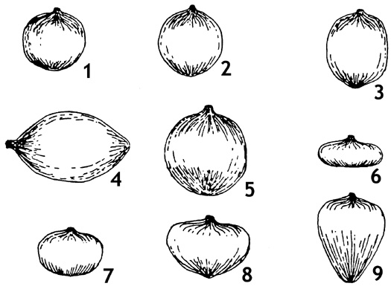
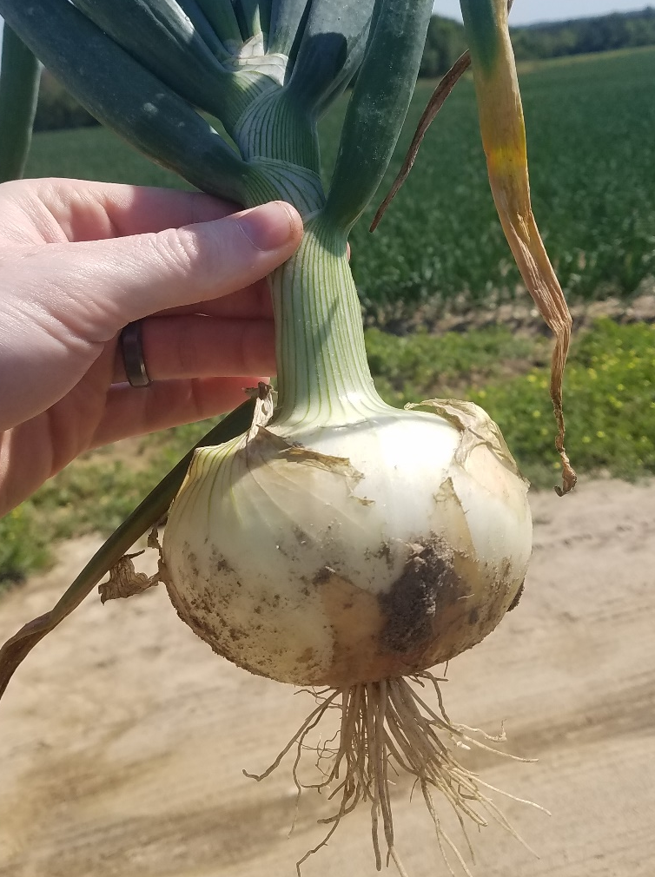
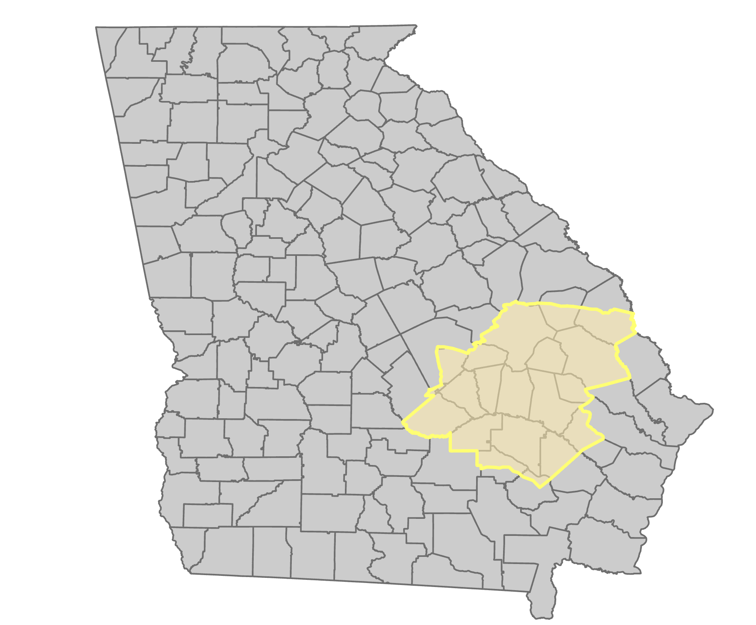

Vidalia Onions
Short-day, Granex type, yellow onions (Allium cepa L.)
Production restricted to 20 counties in southeast Georgia
Annual farmgate value of ~$150 million
Characteristically sweet flavor and low pungency
Onion Bulb Shapes: 1) flattened globe; 2) globe; 3) high globe; 4) spindle; 5) Spanish; 6) flat; 7) thick flat; 8) Granex; 9) top
Boyhan and Torrance, 2002; UGA CAED, 2019

Slide 3
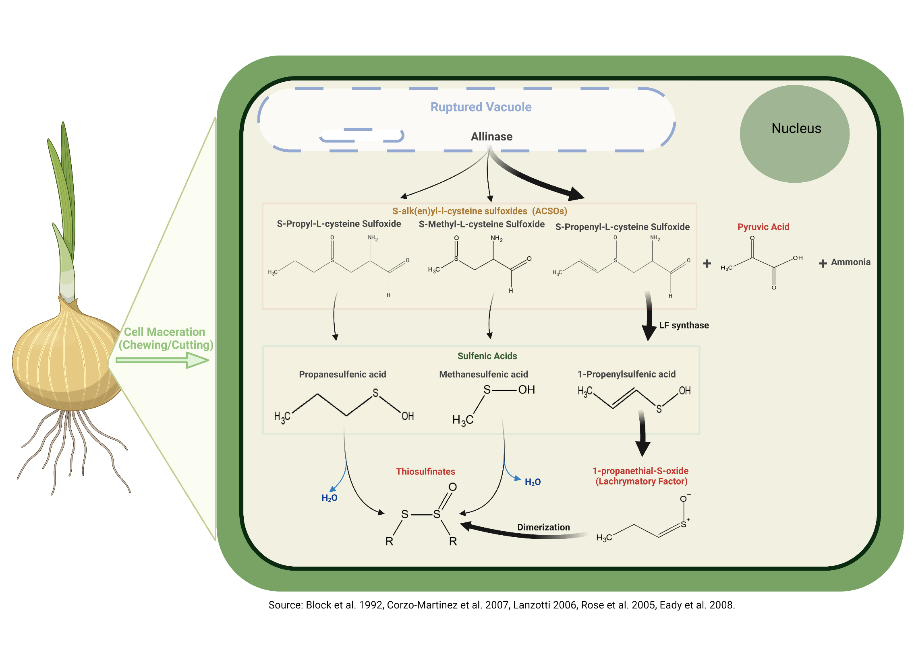

Onion Flavor Chemistry

Slide 4
Onion Flavor Chemistry

Slide 5
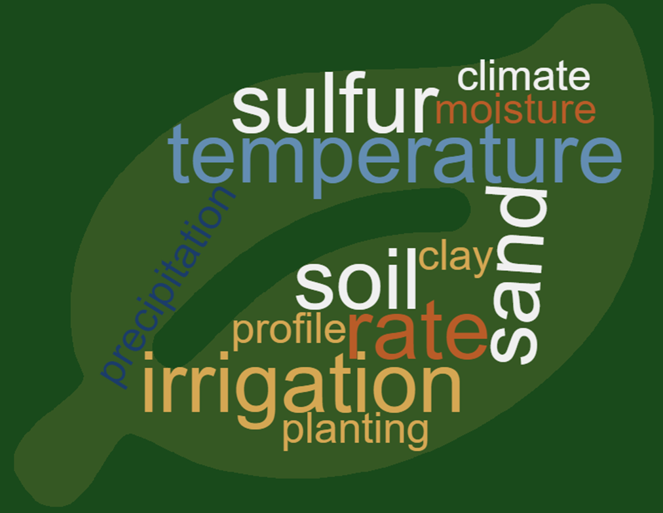
Drivers of Onion Pungency
Onion pungency = genetics x environment
Environment:
  Irrigation
  Root zone temperature
  Nitrogen
  Sulfur
Sulfur availability is the greatest environmental component affecting onion pungency
(Freeman and Mossadeghi, 1970)
Kopsell et al., 2002; Yoo et al., 2006; Randle & Bushard, 1993; Randle et al., 1995; Coolong & Randle, 2003

Slide 6
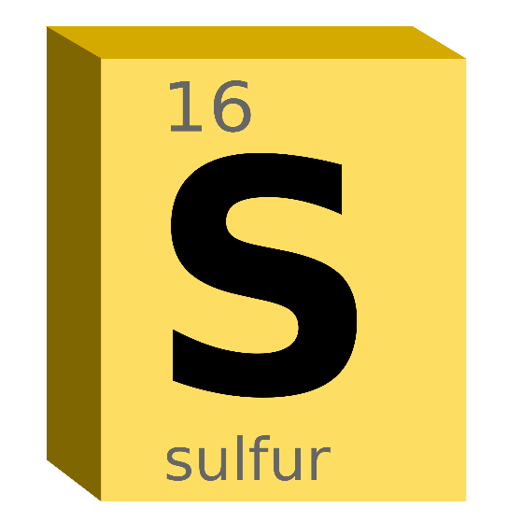
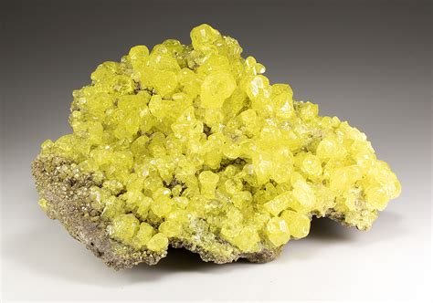
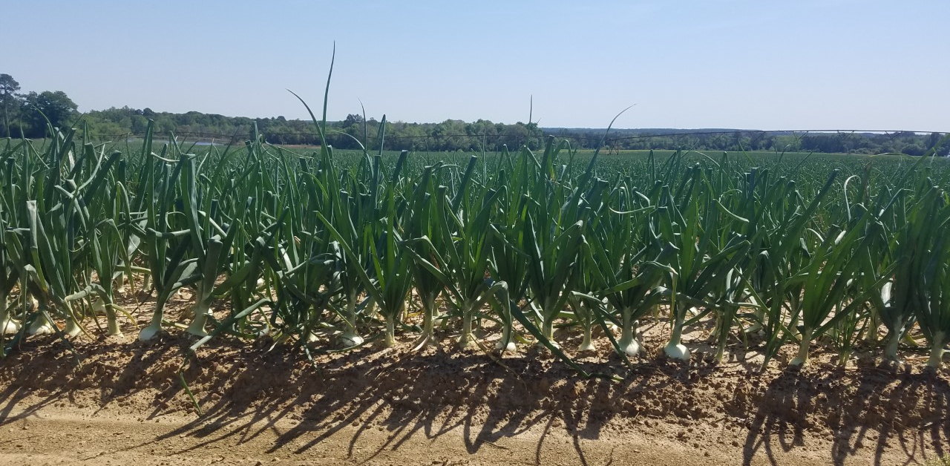
Importance of Sulfur
Sulfur is an essential element for all plants
Too little sulfur causes deficiency symptoms, which can reduce yields
Excess sulfur allows for surplus accumulation within the onion, producing highly pungent onions.
Randle et al. 1995 found a linear increase in concentration in flavor-associated compounds in onions with sulfur fertility.
Randle et al., 1995; Freeman and Mossadehi, 1970

Slide 7
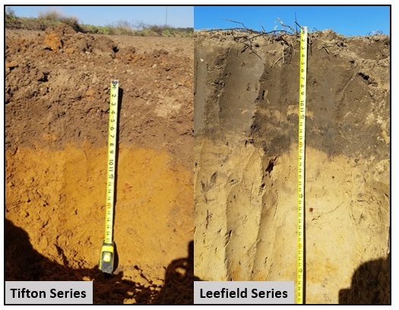
Importance of Soil Characteristic
Soils play a critical role in crop productivity
  Retain and supply nutrients
  Absorb and retain water
  Allow or prevent root penetration
Notes:
-Soils are often overlooked in their contributions to crop productivity and play a critical role in retaining and supplying essential plant nutrients. Soils a

Slide 8
Importance of Soil Characteristic
Research Questions:
Can the soil variability within a single field influence onion pungency?
Which specific soil characteristics influence onion pungency?
Can we manage soil variability?
Short-term
Long-term
Notes:
-Soils are often overlooked in their contributions to crop productivity and play a critical role in retaining and supplying essential plant nutrients. Soils a

Slide 9
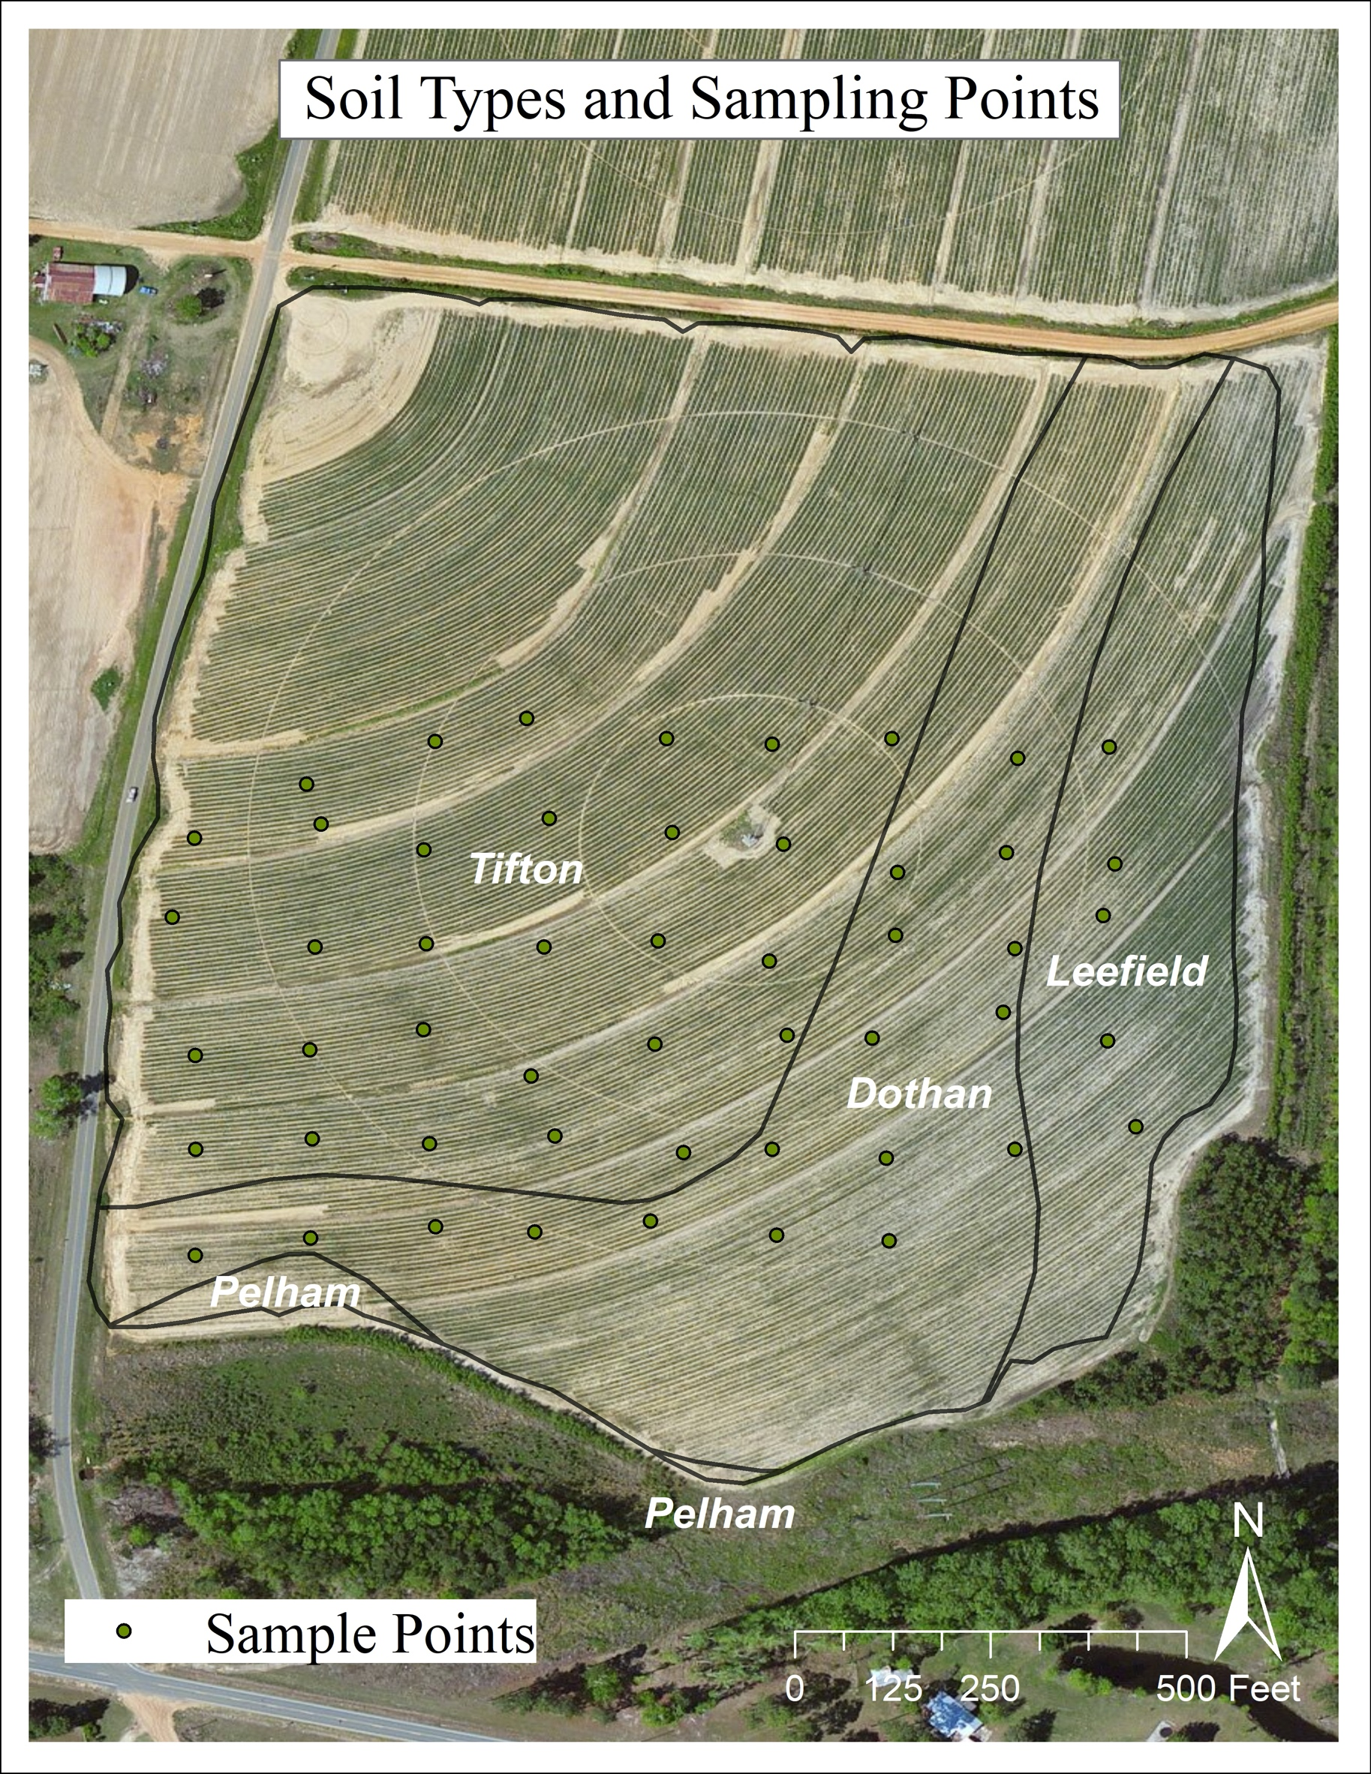
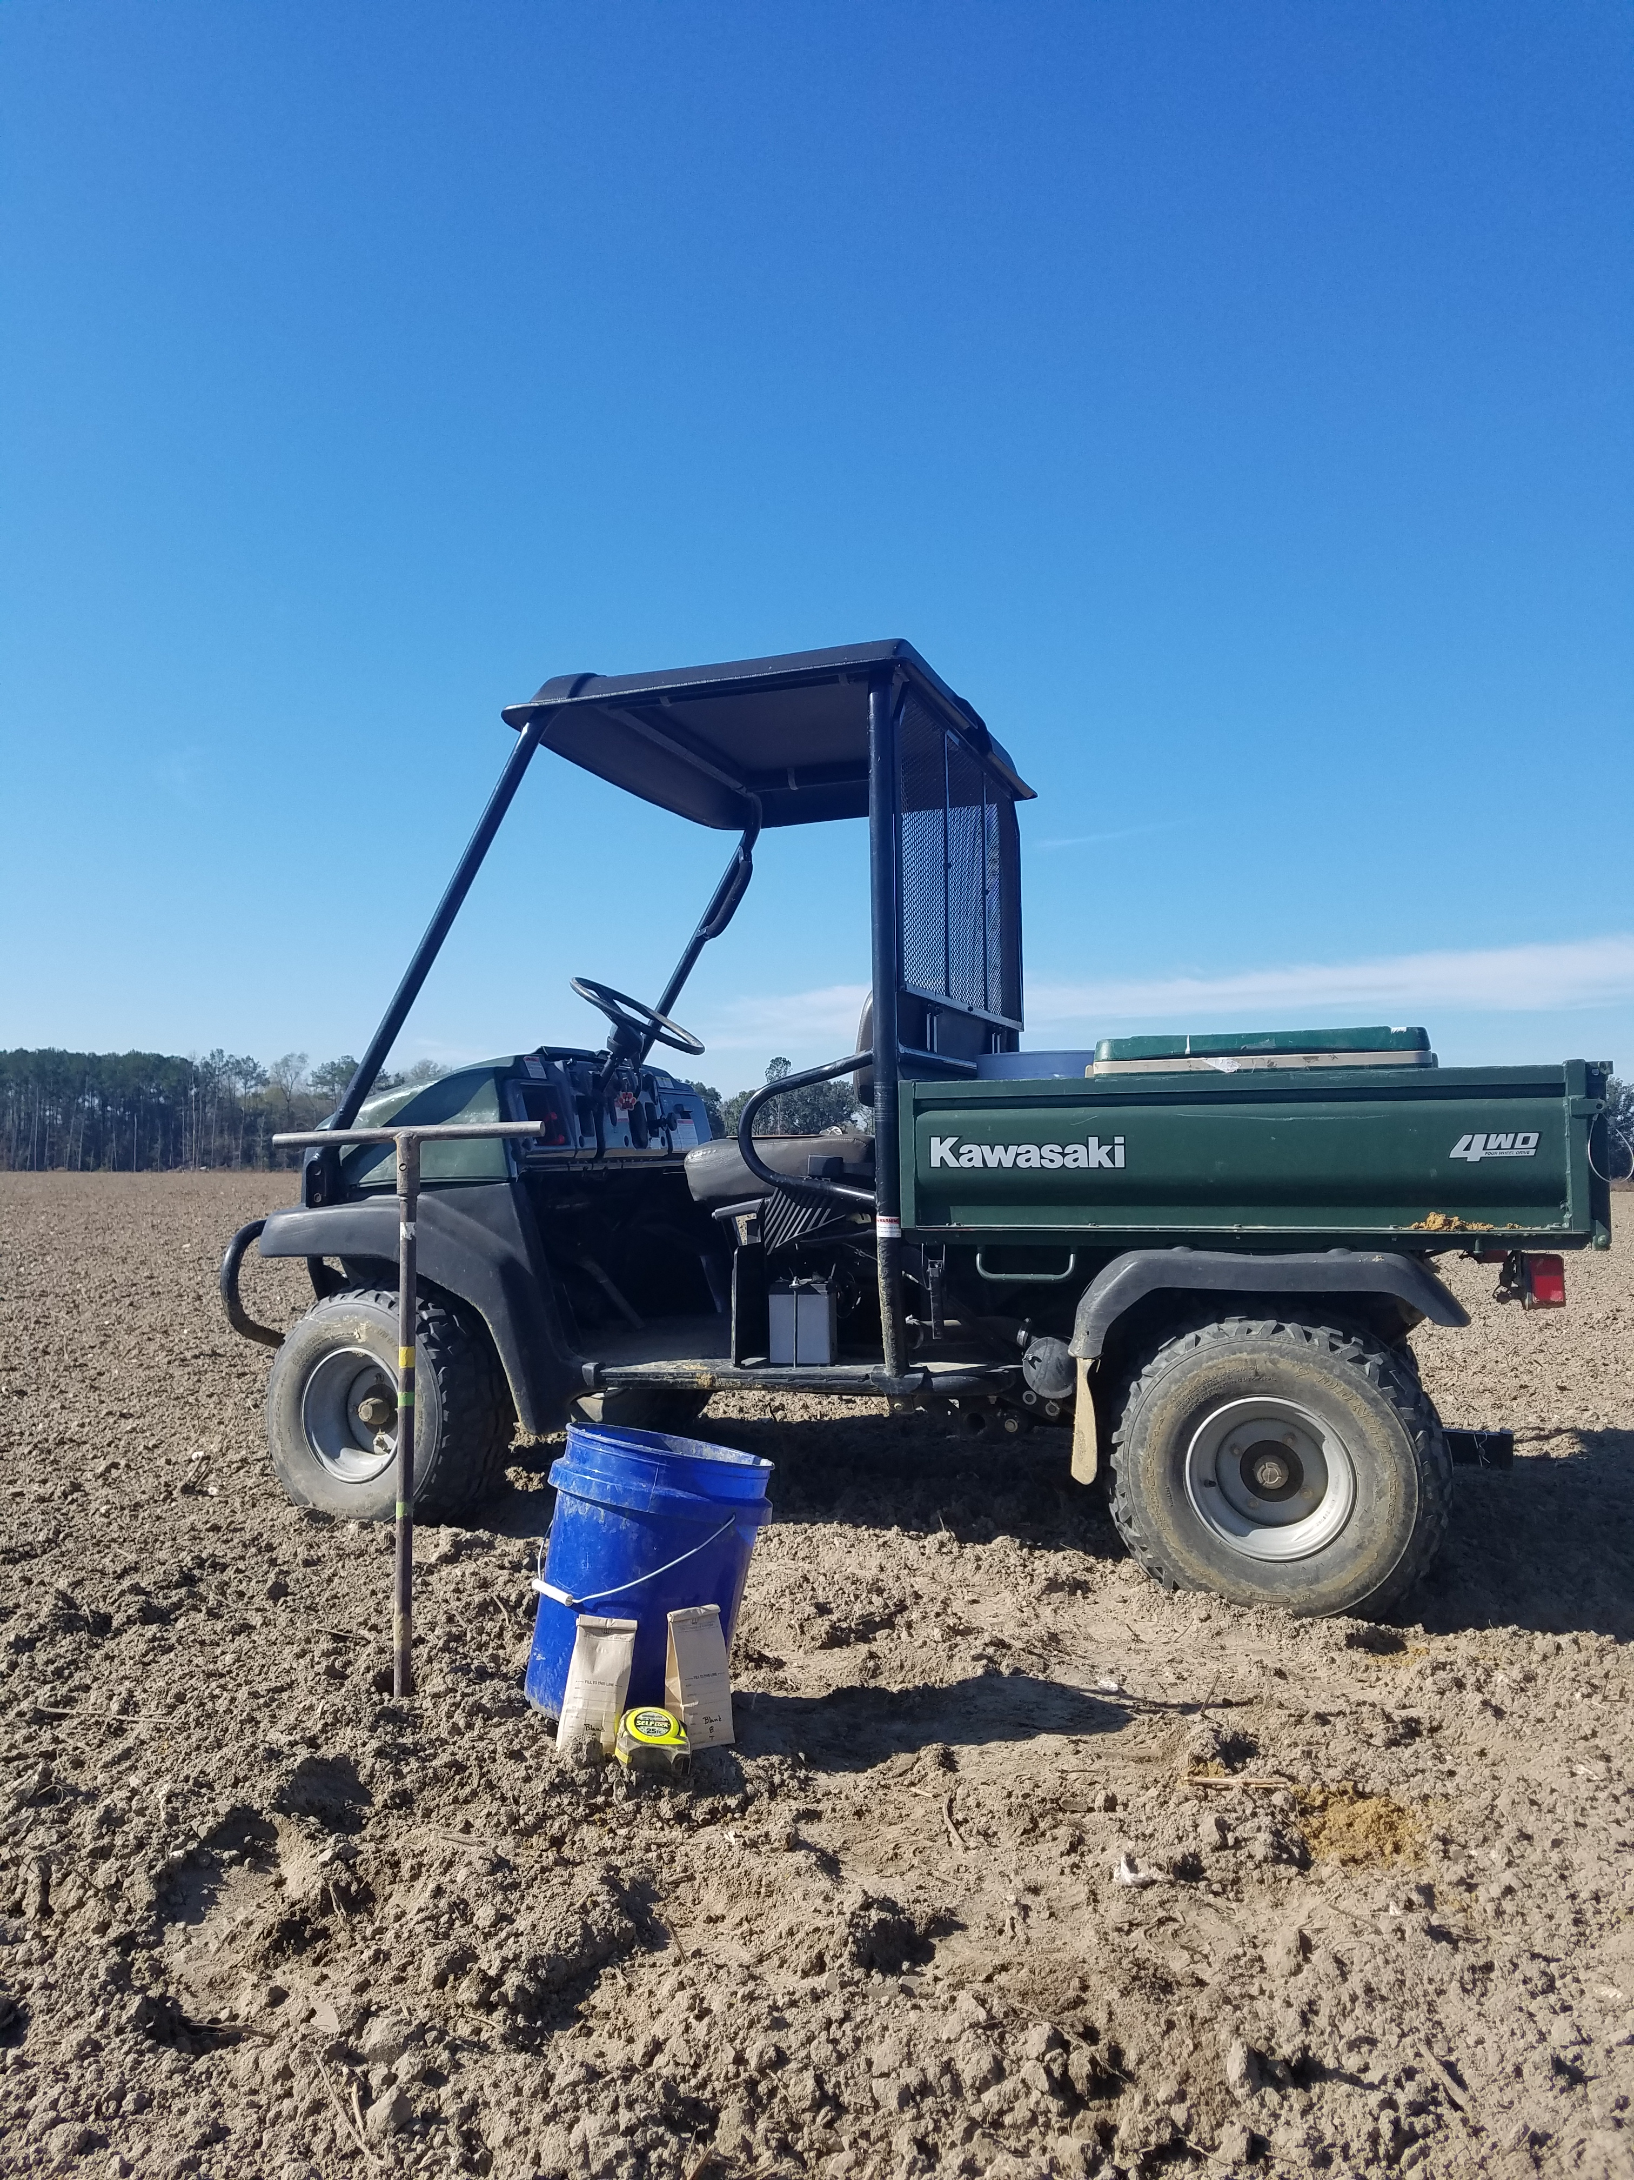
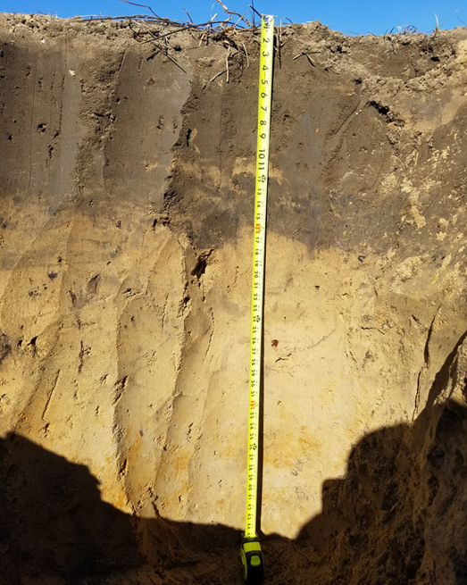
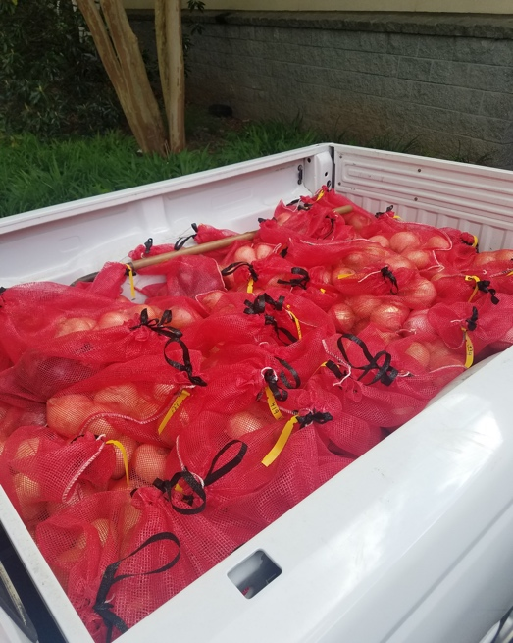
Study Design: 2020
A 26-acre portion of an onion field in Tattnall County was studies during the 2020 growing season.
  Highly variable soil profile
  Tifton, Dothan, and Leefield soil profiles
Sampled on 0.5-acre grids (51 total samples)
Data collected:
  Soil samples prior to planting & fertilization (top 6” and claypan)
    Total and plant available nutrients determined
  Depth to claypan measured
  Plant tissue at bulb initiation & harvest
  Bulbs at harvest for yield and pungency
Managed following the grower’s standard cultivation practices.

Slide 10
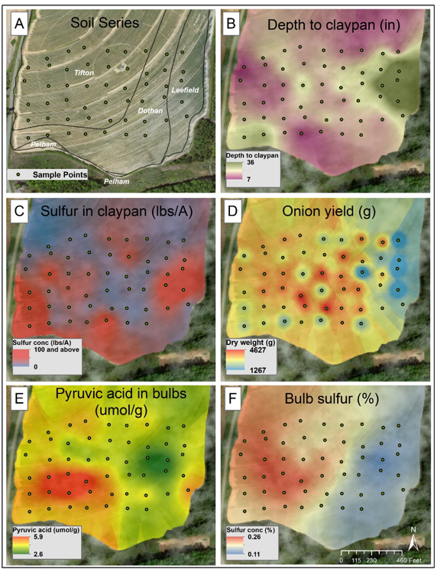
Results: 2020
Claypan depth varied considerably across the field, ranging from 7 to 36 inches
  Corresponded with soil type & landscape position

Slide 11
Results: 2020
Claypan depth varied considerably across the field, ranging from 7 to 36 inches
  Corresponded with soil type & landscape position
Total soil sulfur content ranged from 3-408 lbs./A

Slide 12
Results: 2020
Claypan depth varied considerably across the field, ranging from 7 to 36 inches
  Corresponded with soil type & landscape position
Soil sulfur content ranged from 3-408 lbs./A
Yield were generally higher where the claypan depth was shallow

Slide 13
Results: 2020
Claypan depth varied considerably across the field, ranging from 7 to 36 inches
  Corresponded with soil type & landscape position
Soil sulfur content ranged from 3-408 lbs./A
Yield were generally higher where the claypan depth was shallow
Pyruvic acid was high in soils with a shallow claypan and high sulfur content
Pyruvic acid was low in onion from soils with deep claypan even if those soils had high sulfur concentrations

Slide 14
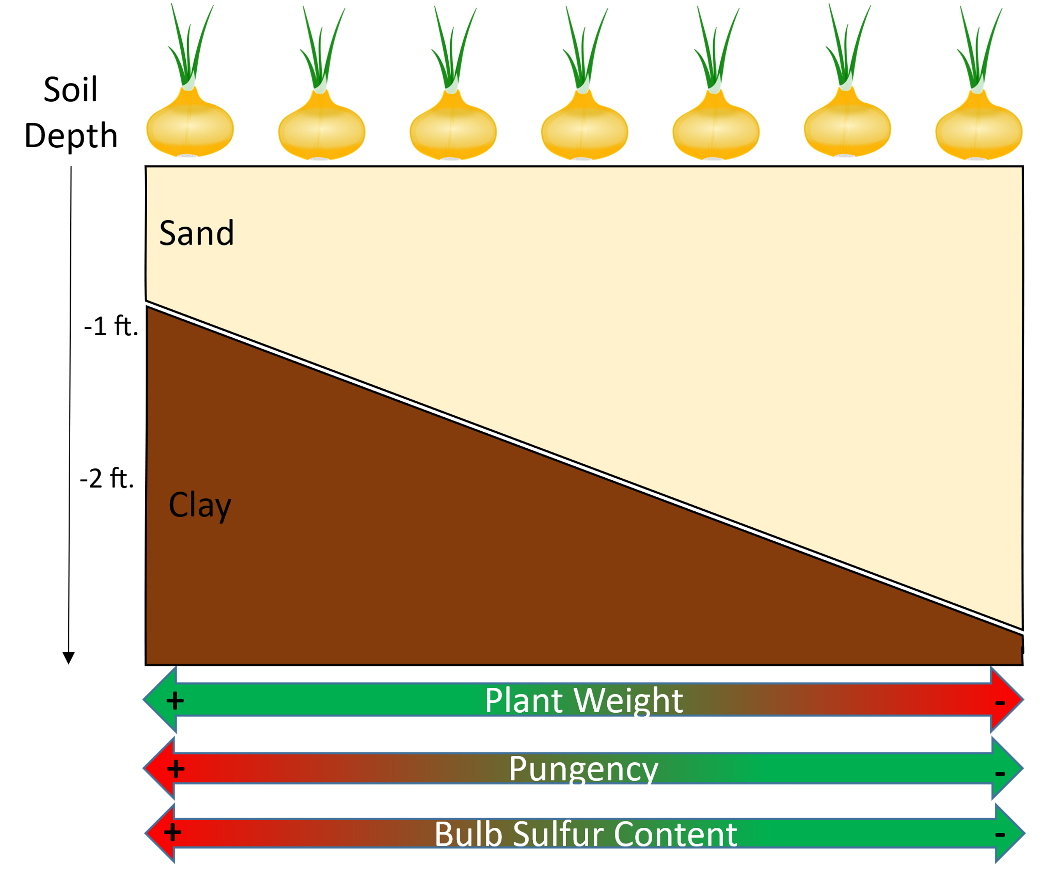
Results: 2020
Onion yield, pungency, and sulfur content were related to claypan depth
As the depth to the claypan increases:
  Pungency decreased
  Bulb sulfur decreased
  Yield decreased

Slide 15
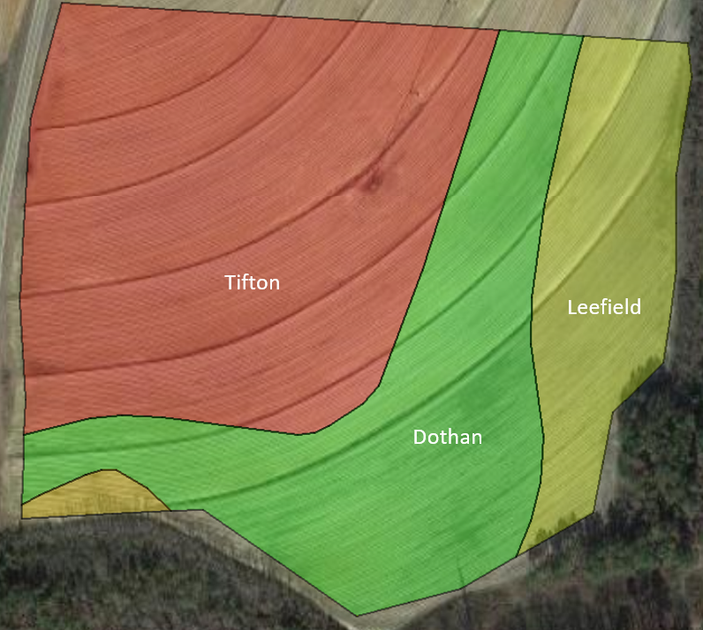
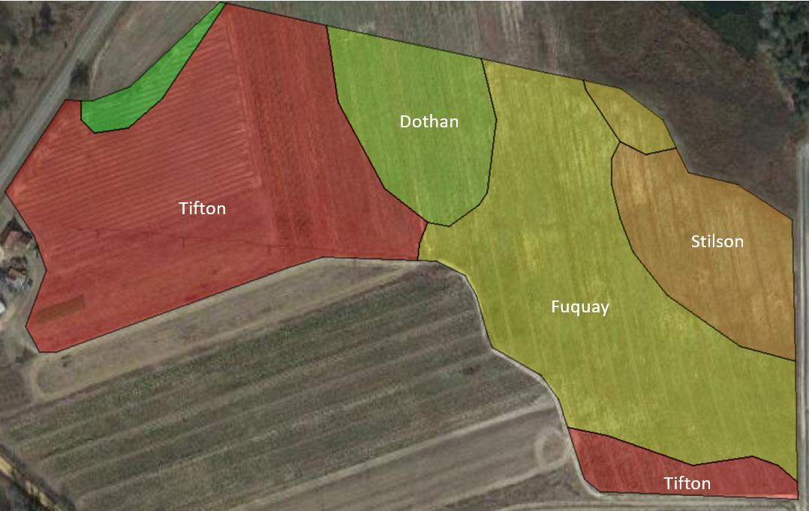
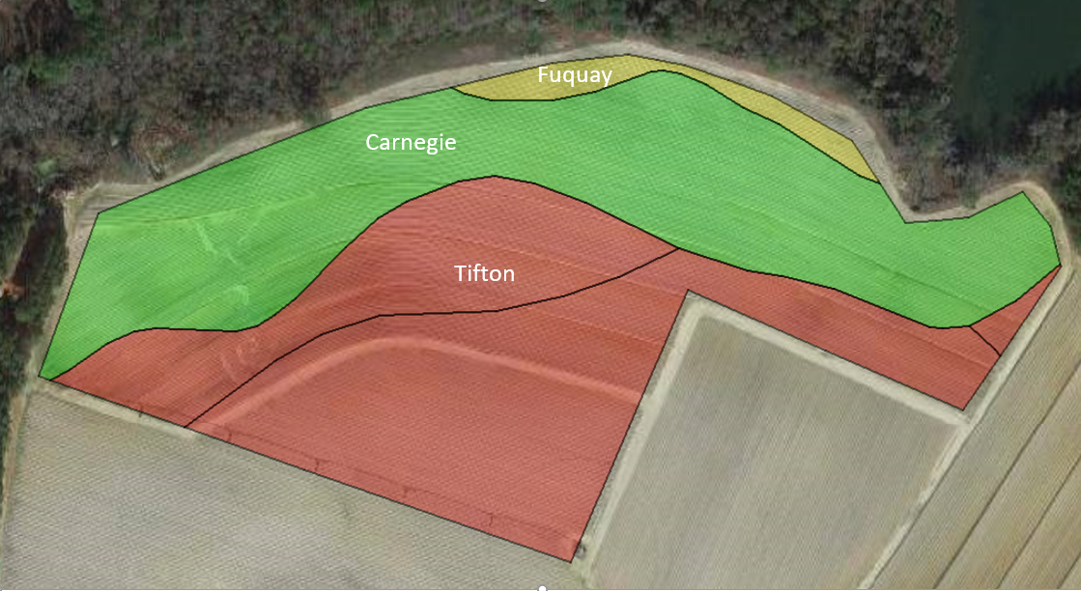
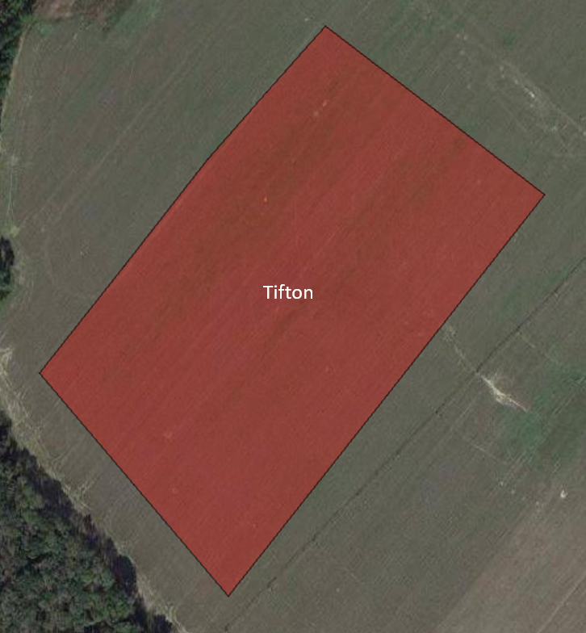
Study Design: 2021
Four onion fields were mapped during the 2021 growing season.
  Tattnall County (repeat)
  Emanuel County
  Toombs County
  Evans County (control)
25-acres, sampled on 0.5-acre grids
Data collected:
  Soil samples prior to planting & fertilization (top 6” and claypan)
  Depth to claypan measured
  Plant tissue at bulb initiation & harvest
  Bulbs at harvest for yield and pungency
Managed following the grower’s standard cultivation practices.
Tattnall County
Emanuel County
Toombs County
Evans County

Slide 16
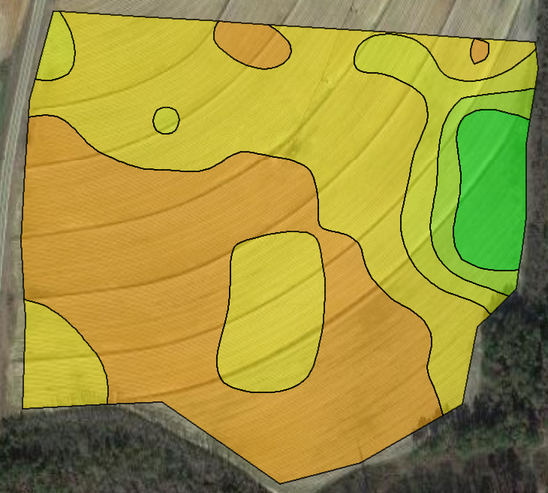
Tattnall County Field
Claypan Depth: 8-38 inches
Depth to Claypan (cm)

Slide 17
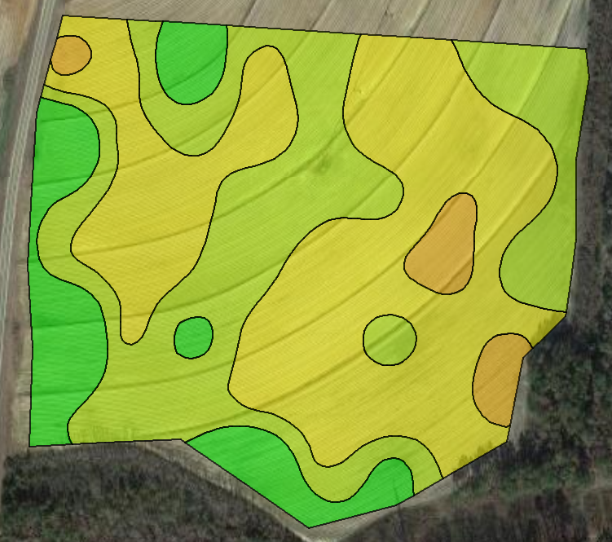
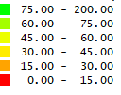
Tattnall County Field
Claypan Depth: 8-38 inches
Claypan Sulfur: 68-490 lbs. S/A
Depth to Claypan (cm)
Claypan Sulfur (ppm)
P=0.29

Slide 18
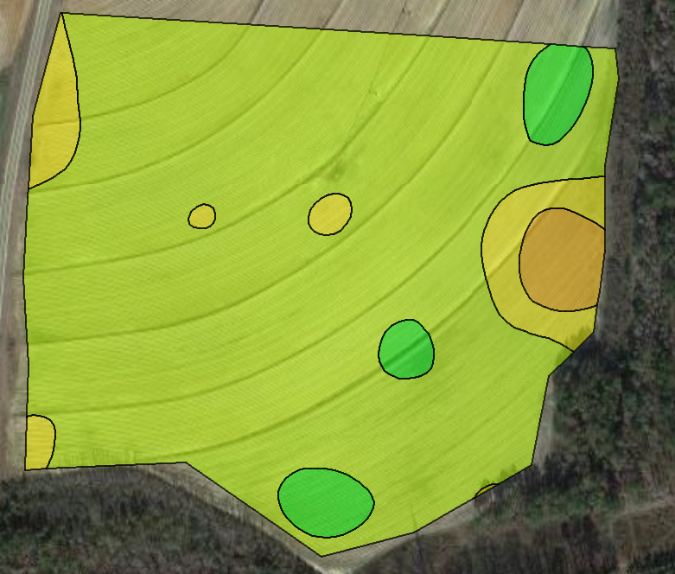
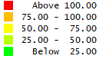
Tattnall County Field
Claypan Depth: 8-38 inches
Claypan Sulfur: 68-490 lbs. S/A
Bulb d.w.: 74-219 g
  Spotty distribution
Depth to Claypan (cm)
Claypan Sulfur (ppm)
Bulb d.w. (g)
P=0.29
P<0.05

Slide 19
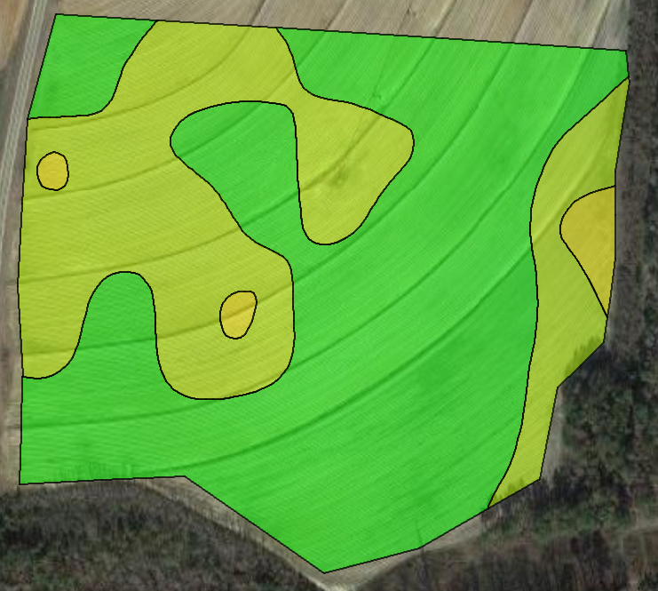
Tattnall County Field
Claypan Depth: 8-38 inches
Claypan Sulfur: 68-490 lbs. S/A
Bulb d.w.: 74-219 g
  Spotty distribution
Pyruvic acid: 1.2-4.3 µmol/g
Depth to Claypan (cm)
Claypan Sulfur (ppm)
Bulb d.w. (g)
P=0.29
P<0.05
Pyruvic Acid (µmol/g)
P=0.78

Slide 20
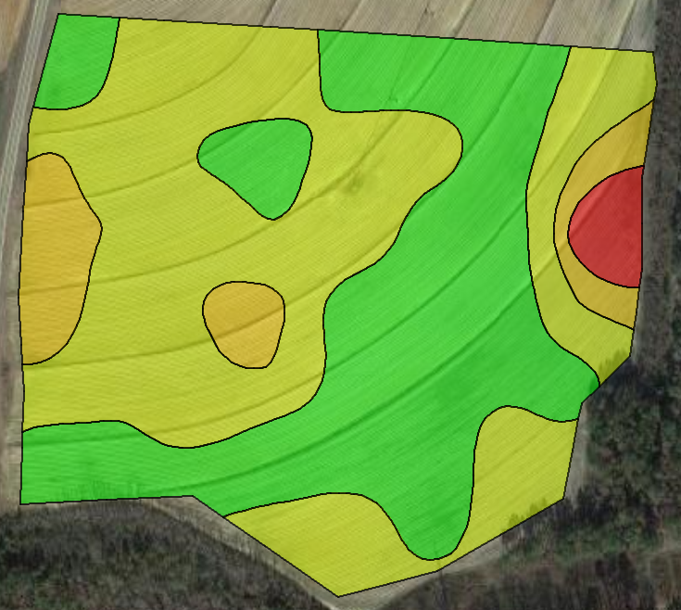
Tattnall County Field
Claypan Depth: 8-38 inches
Claypan Sulfur: 68-490 lbs. S/A
Bulb d.w.: 74-219 g
  Spotty distribution
Pyruvic acid: 1.2-4.3 µmol/g
Lachrymatory Factor: 0.6-6.2 µmol/g
  Single point influencing results
Depth to Claypan (cm)
Claypan Sulfur (ppm)
Bulb d.w. (g)
P=0.29
P<0.05
Pyruvic Acid (µmol/g)
LF (µmol/g)
P=0.78
P=0.72

Slide 21
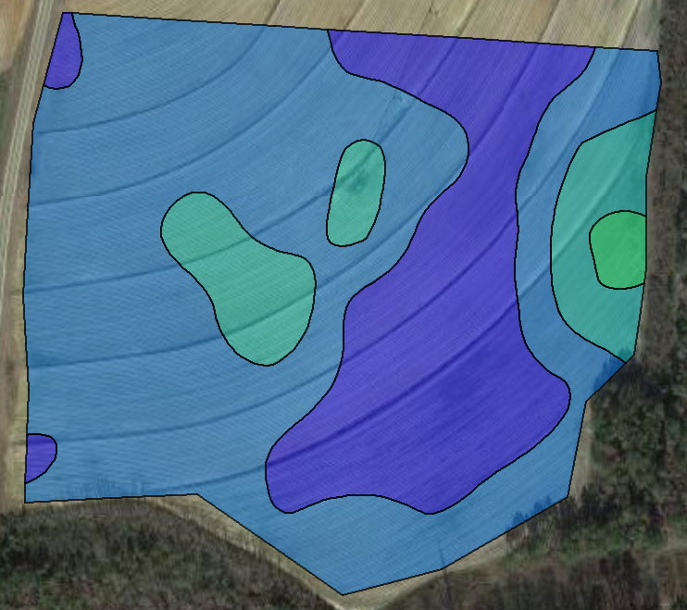
Tattnall County Field
Claypan Depth: 8-38 inches
Claypan Sulfur: 68-490 lbs. S/A
Bulb d.w.: 74-219 g
  Spotty distribution
Pyruvic acid: 1.2-4.3 µmol/g
Lachrymatory Factor: 0.6-6.2 µmol/g
  Single point influencing results
Foliar Sulfur: 0.14-0.42 %
Depth to Claypan (cm)
Claypan Sulfur (ppm)
Bulb d.w. (g)
P=0.29
P<0.05
Pyruvic Acid (µmol/g)
LF (µmol/g)
Leaf Sulfur Content (%)
P=0.78
P=0.72
P=0.09

Slide 22
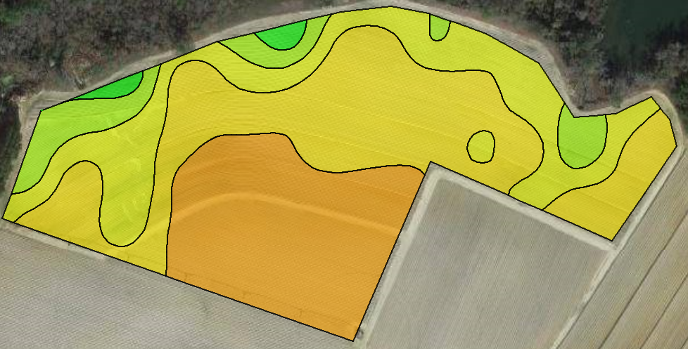
Toombs County Field
Depth to Claypan (cm)

Slide 23
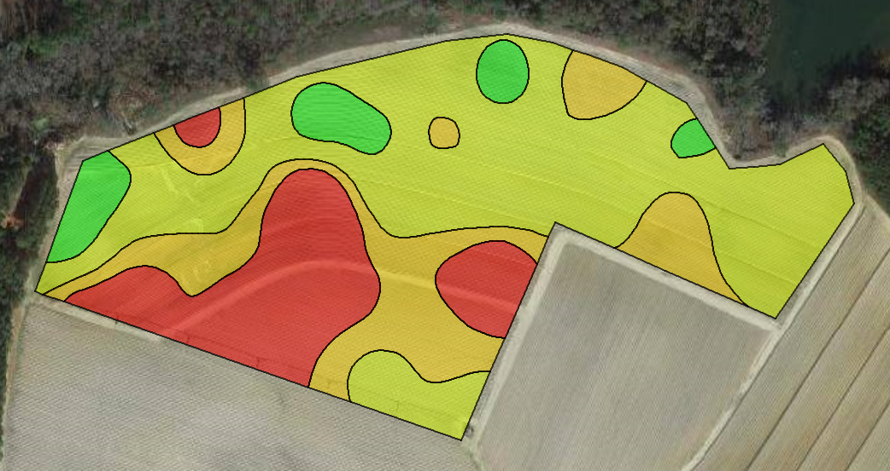
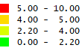
Toombs County Field
Depth to Claypan (cm)
Lachrymatory Factor (µmol/g)
P<0.05

Slide 24
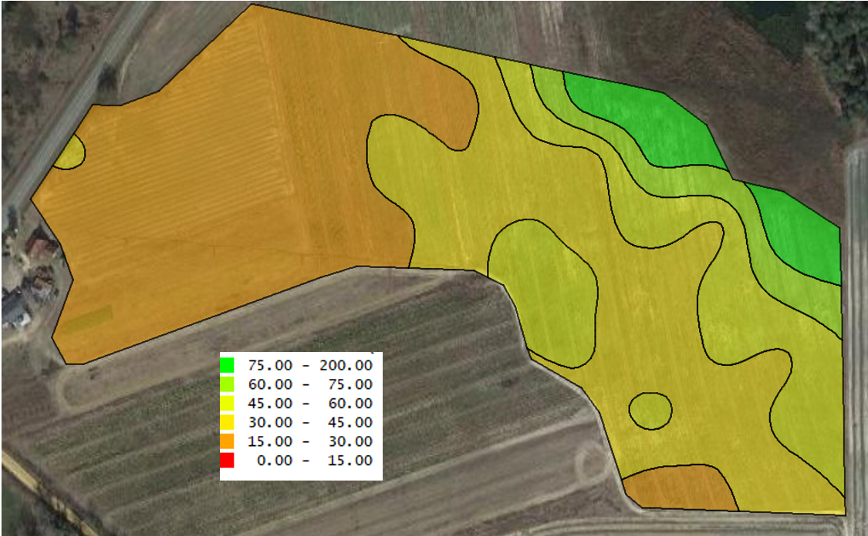
Emanuel County Field
Depth to Claypan (cm)

Slide 25
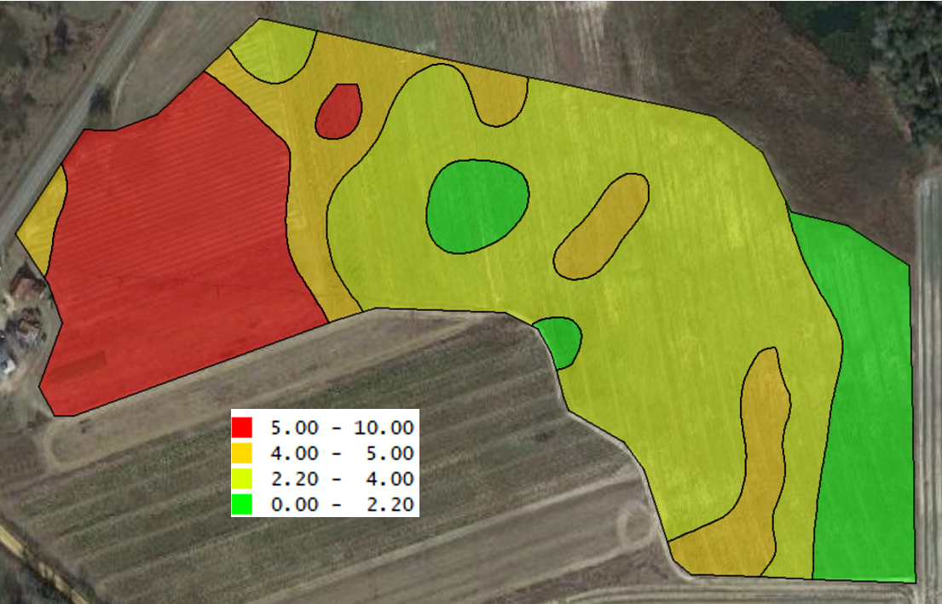
Emanuel County Field
Depth to Claypan (cm)
Lachrymatory Factor (µmol/g)
P<0.05

Slide 26
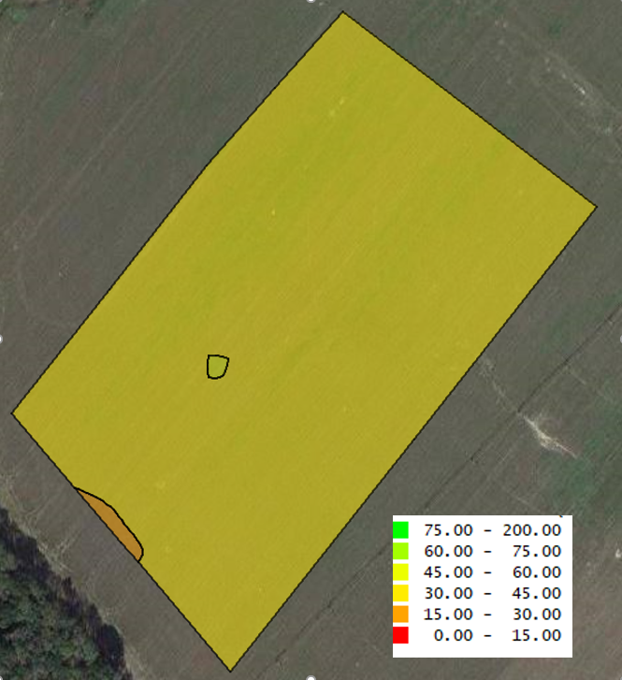
Evans County Field (Control)
Depth to Claypan (cm)

Slide 27
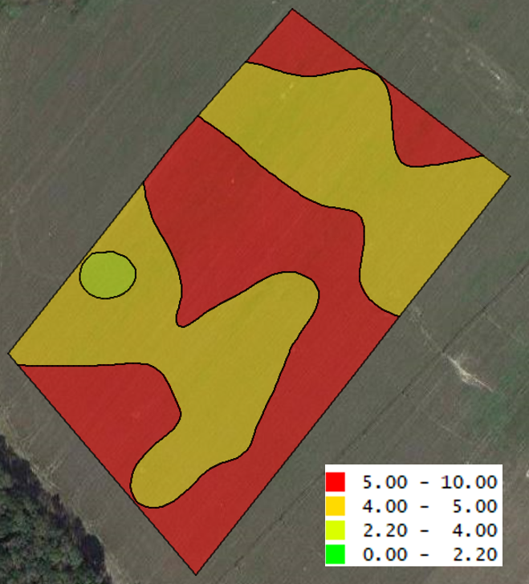
Evans County Field (Control)
Depth to Claypan (cm)
Lachrymatory Factor (µmol/g)
P=0.85

Slide 28
Results Summary
In general, we saw similar relationships in 2021, as we did in 2020
As claypan depth increases, onions become less pungent
Bulb d.w (yield) was less strongly related to pungency, sulfur, or depth to clay in 2021
  Mixed statistical relationship among fields

Slide 29
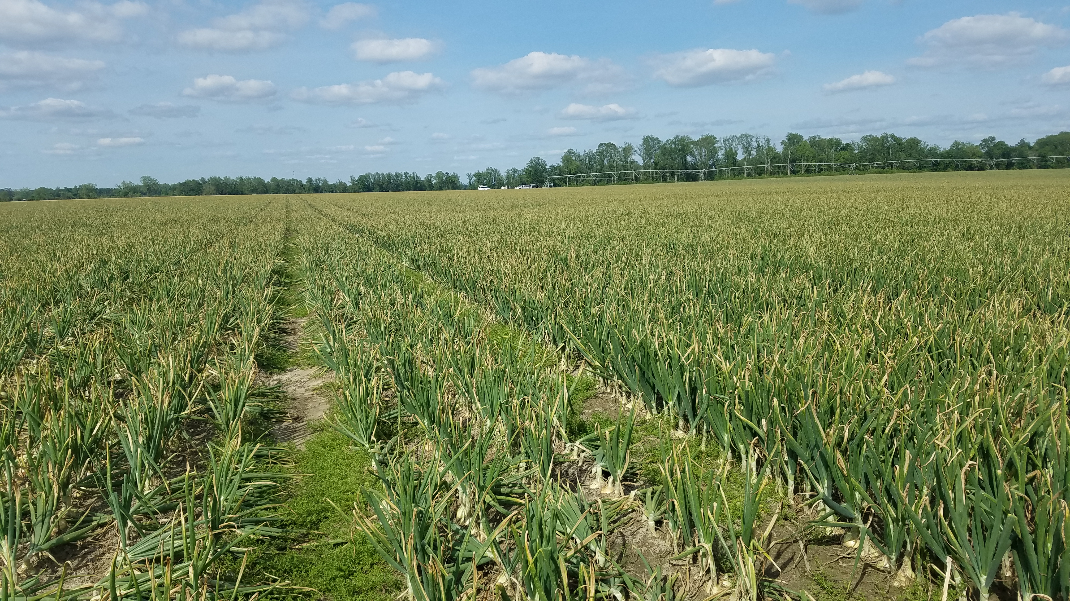
Conclusions
A tremendous amount of variability exists within and among Vidalia onion fields.
The soil A horizon thickness was identified as major factor in nutrient availability and onion yield and quality.
The physical and chemical differences among soils within 25-acre areas was sufficient to affect nutrient availability and alter onion yield and quality.
Site-specific fertilizer recommendations and management plans may be needed in the Vidalia region to ensure consistency of onion quality and yield.

Slide 30
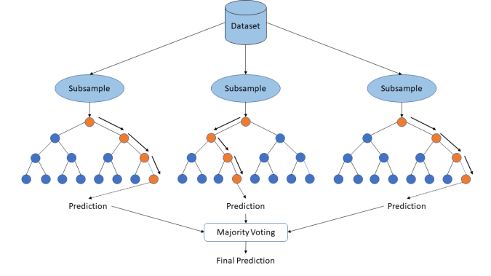
Next Steps
Use machine learning algorithms to tease out interactions among soil properties and their relative contributions to onion pungency.

Slide 31
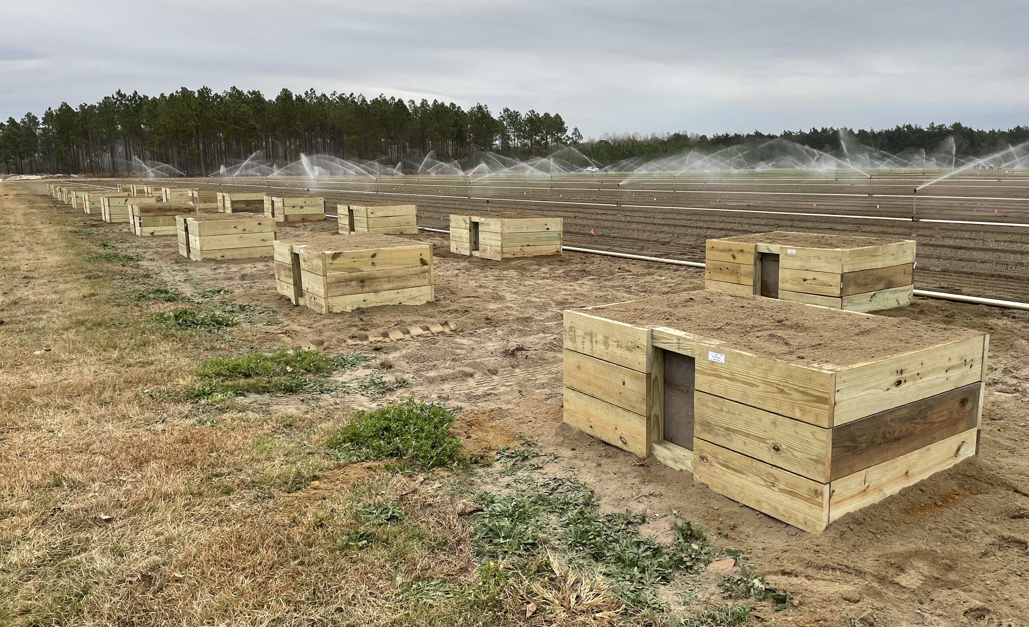
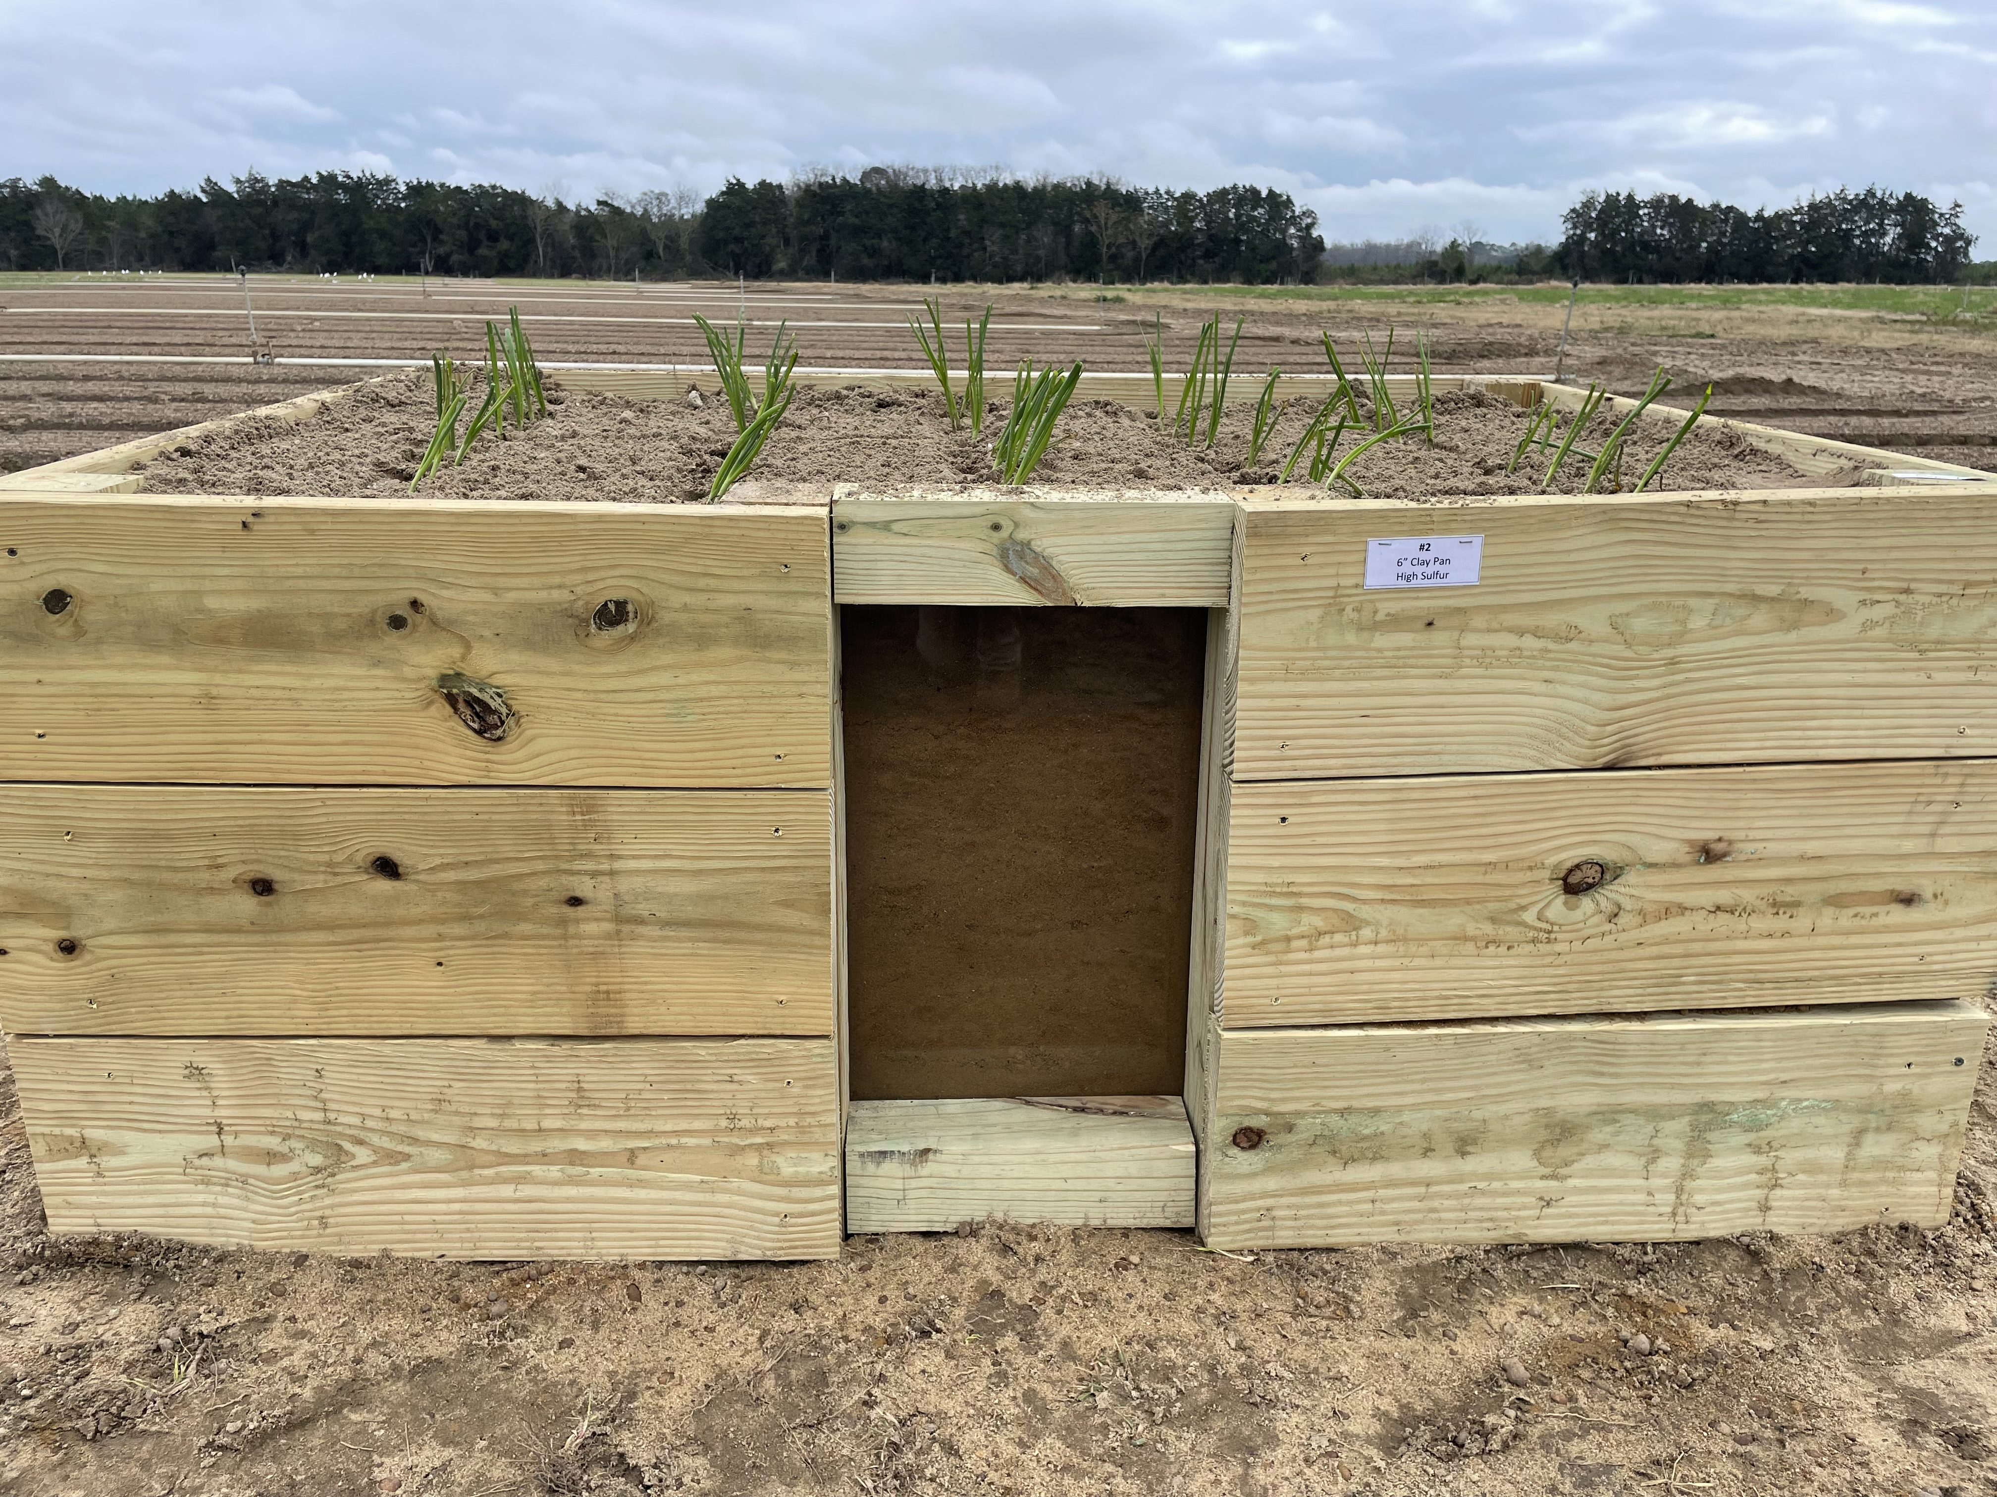
Follow-up Studies
Verify the relationship between claypan depth and onion pungency under a controlled setting
Use three claypan depths (6, 12, 18 inches) and two sulfur rates (~50 and 200 lbs/A)
Determine the critical claypan depth for sulfur uptake
  Track onion root growth visually and using stable isotope S³⁴
Claypan

Slide 32
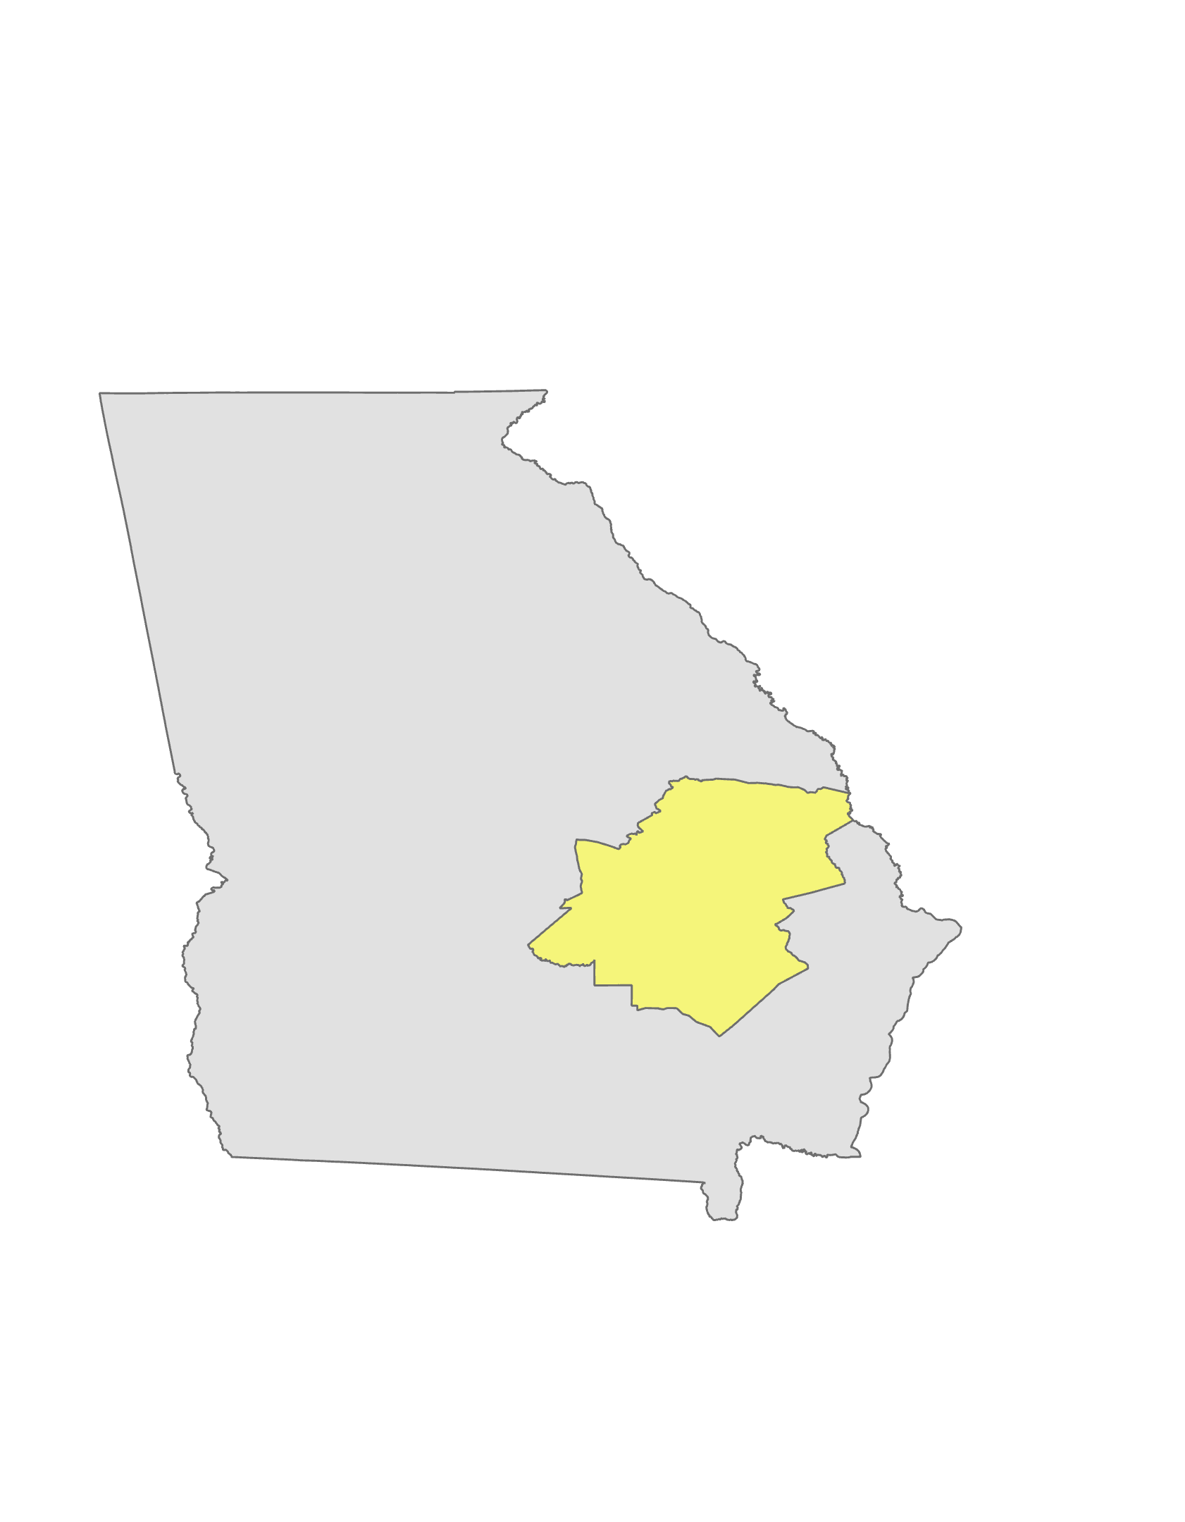
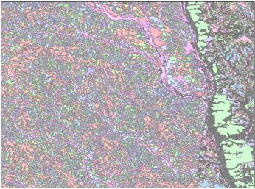
Follow-up Studies
Conduct a survey of soil characteristics across the Vidalia production region
  Soil characteristics
  Onion pungency
Sample ≥10% of production acreage

Slide 33
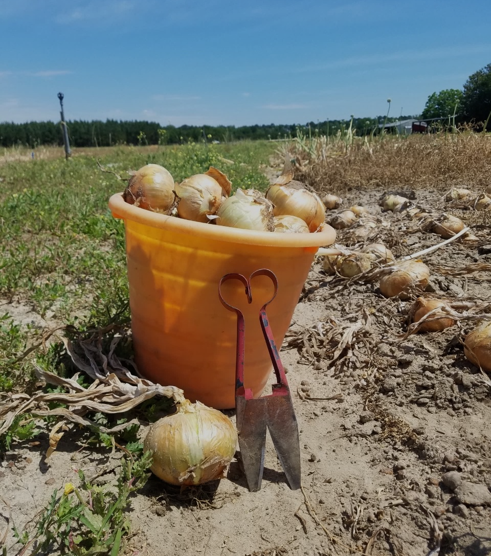
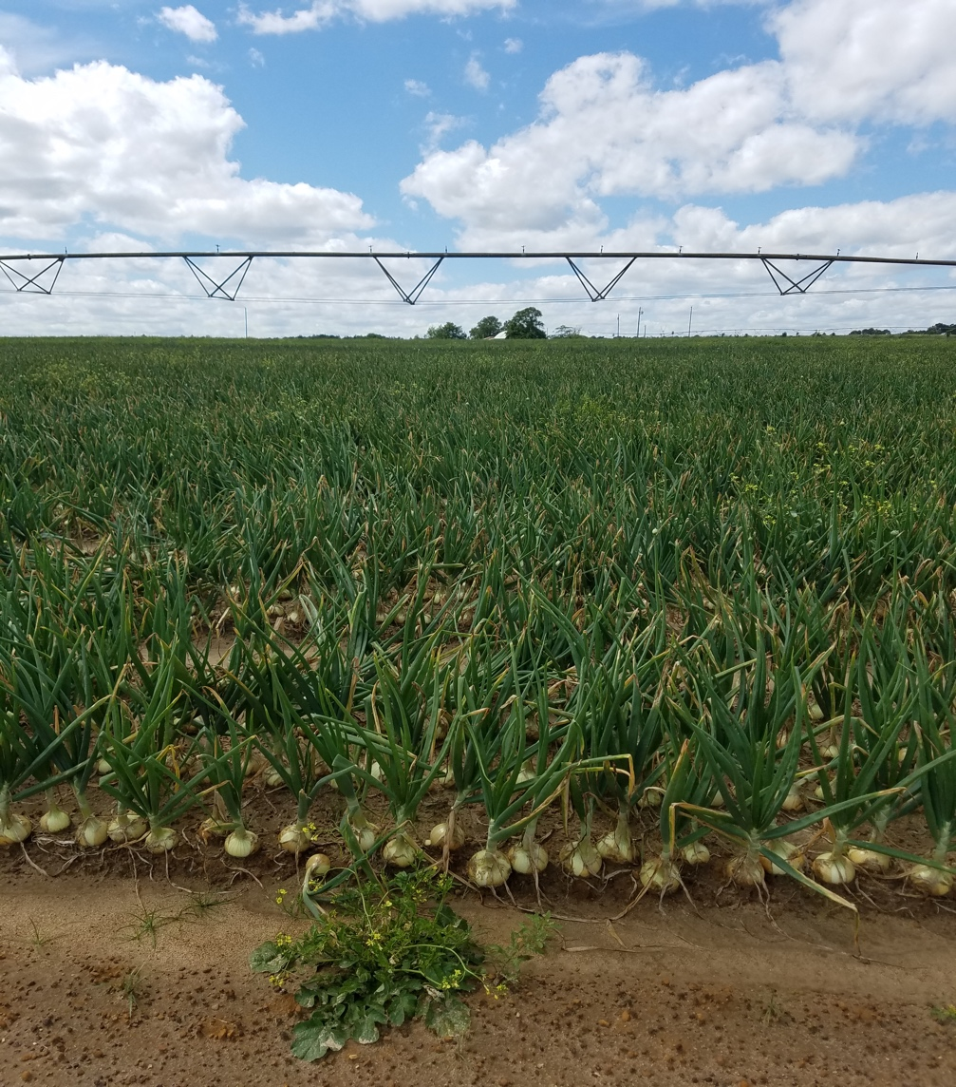
Thank You!
Vidalia Onion Committee
UGA Vidalia Onion and Vegetable Research Center
Chris Tyson, Area Onion Agent
Denny Thigpen
Daniel Clark
UGA Extension Agents
Aubrey Shirley, Tattnall County
Derrick Bowen, Tattnall County
Jason Edenfield, Toombs County
Savannah Tanner, Emanuel County
Steven Powell, Treutlen County
Ross Greene, Evans County

Slide 34
Summary Statistics Table
 | Depth to Claypan (cm) |  |  | Claypan Sulfur (ppm) |  |  | Bulb d.w. (g) |  |  | Pyruvic Acid (µmol/mL) |  |  | Lachrymatory Factor (µmol/mL) |  |  | Leaf Sulfur Content (%)
Field Location | Min | Max | Avg | Min | Max | Avg | Min | Max | Avg | Min | Max | Avg | Min | Max | Avg | Min | Max | Avg
Emanual County | 6 | 38 | 15 | 0 | 155 | 59 | 37 | 209 | 117 | 0.8 | 6.4 | 4.2 | 0.2 | 7.1 | 3.9 | 0.12 | 0.91 | 0.91
Evans County | 12 | 18 | 15 | 1 | 188 | 64 | 169 | 252 | 213 | 2.4 | 4.8 | 3.8 | 3.6 | 6.8 | 5.0 | 0.06 | 0.25 | 0.25
Tattnall County | 8 | 38 | 14 | 34 | 245 | 79 | 74 | 219 | 174 | 1.2 | 4.3 | 2.7 | 0.6 | 6.2 | 2.6 | 0.14 | 0.42 | 0.42
Toombs County | 6 | 36 | 16 | 37 | 252 | 88 | 149 | 309 | 251 | 1.0 | 4.5 | 3.0 | 0.5 | 8.9 | 4.1 | 0.14 | 0.46 | 0.46

Slide 35
Tattnall County Field
Pearson’s correlation among measured attributes
Red indicates statistically significant relationship (P≤0.05)

Slide 36
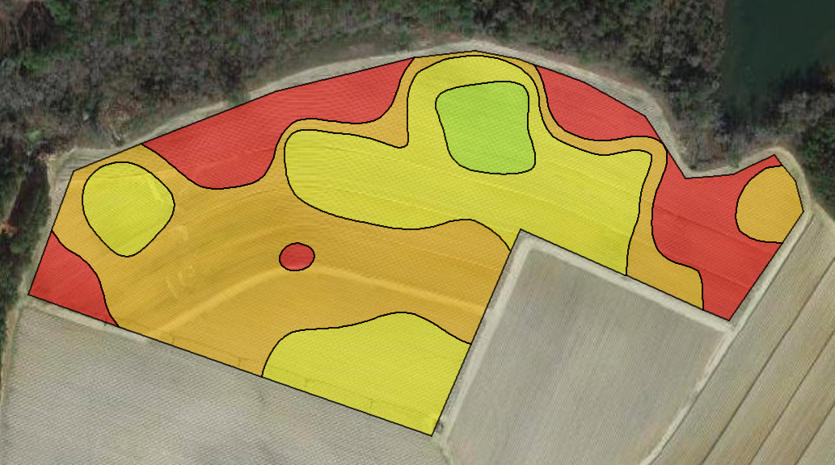
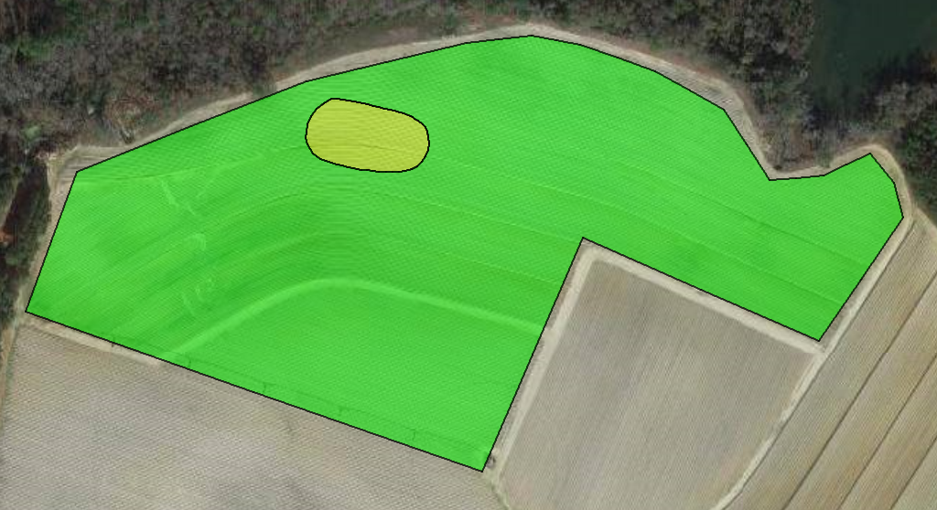
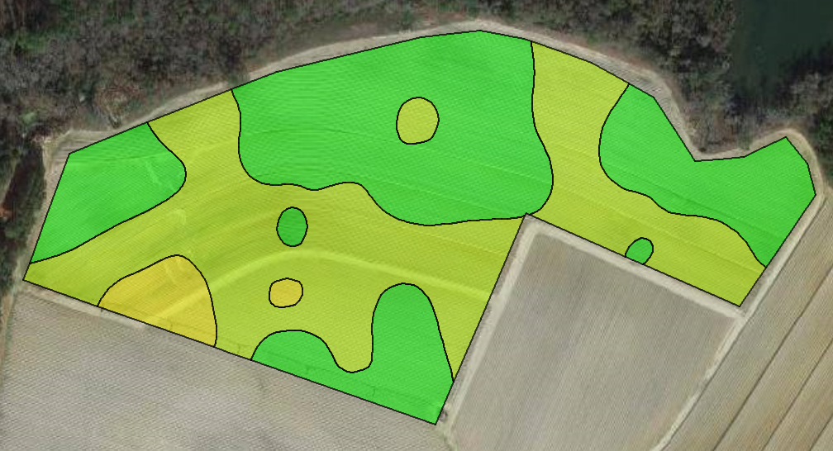
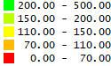
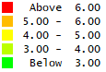
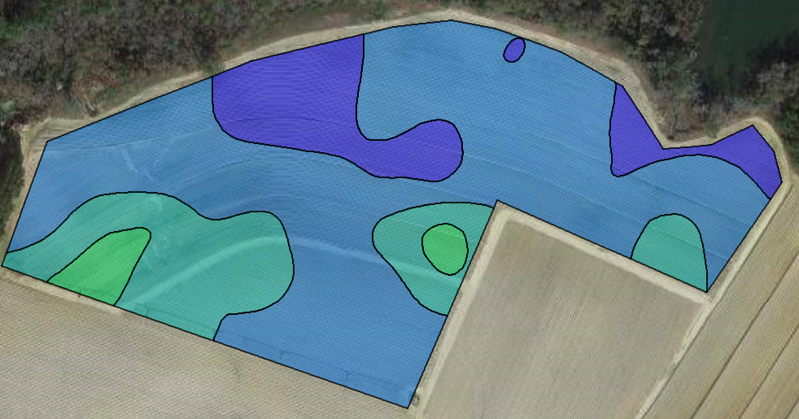
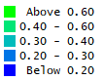
Toombs County Field
Depth to Claypan (cm)
Claypan Sulfur (ppm)
Bulb d.w. (g)
Pyruvic Acid (µmol/g)
Lachrymatory Factor (µmol/g)
Leaf Sulfur Content (%)

Slide 37
Toombs County Field
Pearson’s correlation among measured attributes
Red indicates statistically significant relationship (P≤0.05)

Slide 38




Emanuel County Field
Depth to Claypan (cm)
Claypan Sulfur (ppm)
Bulb d.w (g)
Pyruvic Acid (µmol/g)
Lachrymatory Factor (µmol/g)
Leaf Sulfur Content (%)

Slide 39
Emanuel County Field
Pearson’s correlation among measured attributes
Red indicates statistically significant relationship (P≤0.05)

Slide 40




Evans County Field (Control)
Depth to Claypan (cm)
Claypan Sulfur (ppm)
Bulb d.w. (g)
Pyruvic Acid (µmol/g)
LF (µmol/g)
Leaf Sulfur Content (%)

Slide 41
Evans County Field (Control)
Pearson’s correlation among measured attributes
Red indicates statistically significant relationship (P≤0.05)

